Slide 1
Internal Model Control

Slide 2

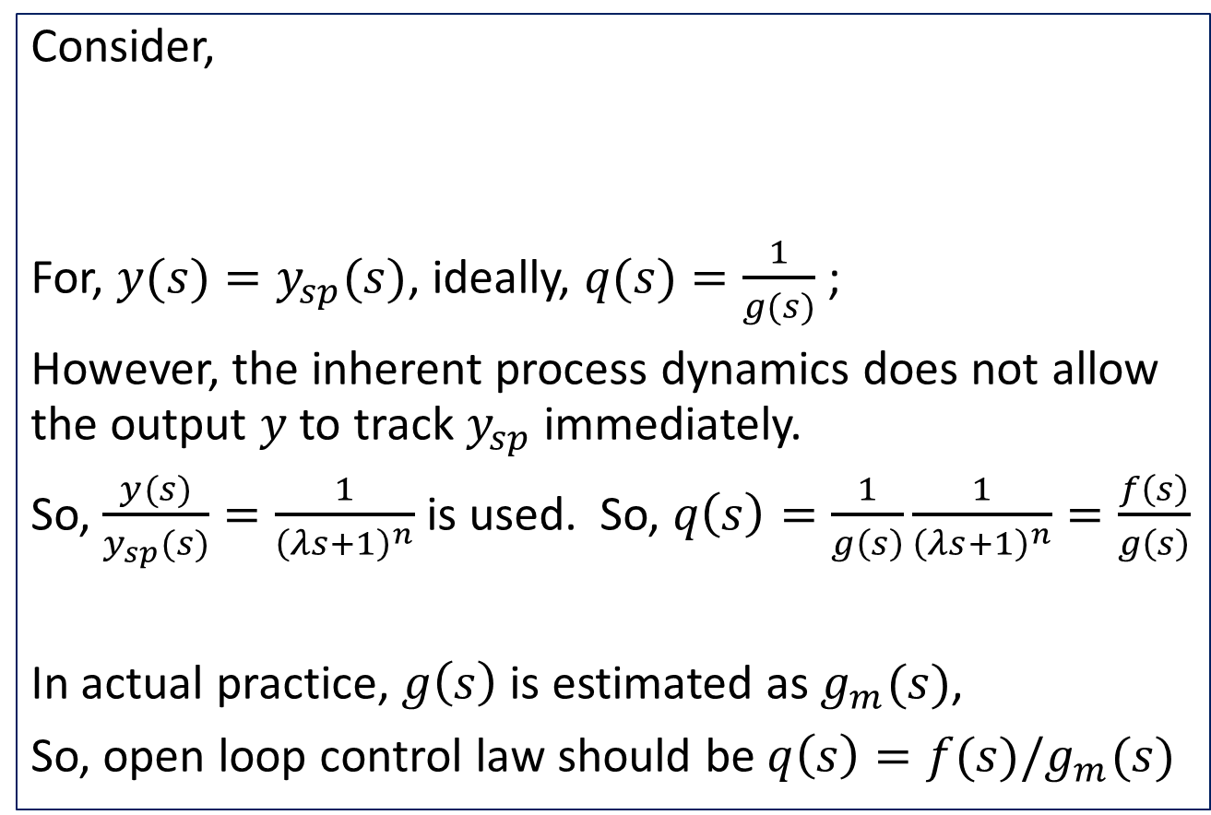



Open loop Control
Consider,
For, $y(s)=y_{sp}(s)$, ideally, $q(s)=\frac{1}{g(s)}$ ;
However, the inherent process dynamics does not allow the output $y$ to track $y_{sp}$ immediately.
So, $\frac{y(s)}{y_{sp}(s)}=\frac{1}{{\left(λs+1\right)}^{n}}$ is used. So, $q\left(s\right)=\frac{1}{g\left(s\right)}\frac{1}{{\left(λs+1\right)}^{n}}=\frac{f\left(s\right)}{g\left(s\right)}$
In actual practice, $g\left(s\right)$ is estimated as $g_{m}(s)$,
So, open loop control law should be $q\left(s\right)=f(s)/g_{m}(s)$
$$y_{sp}$$
$$q$$
$$g$$
$$y$$

Slide 3
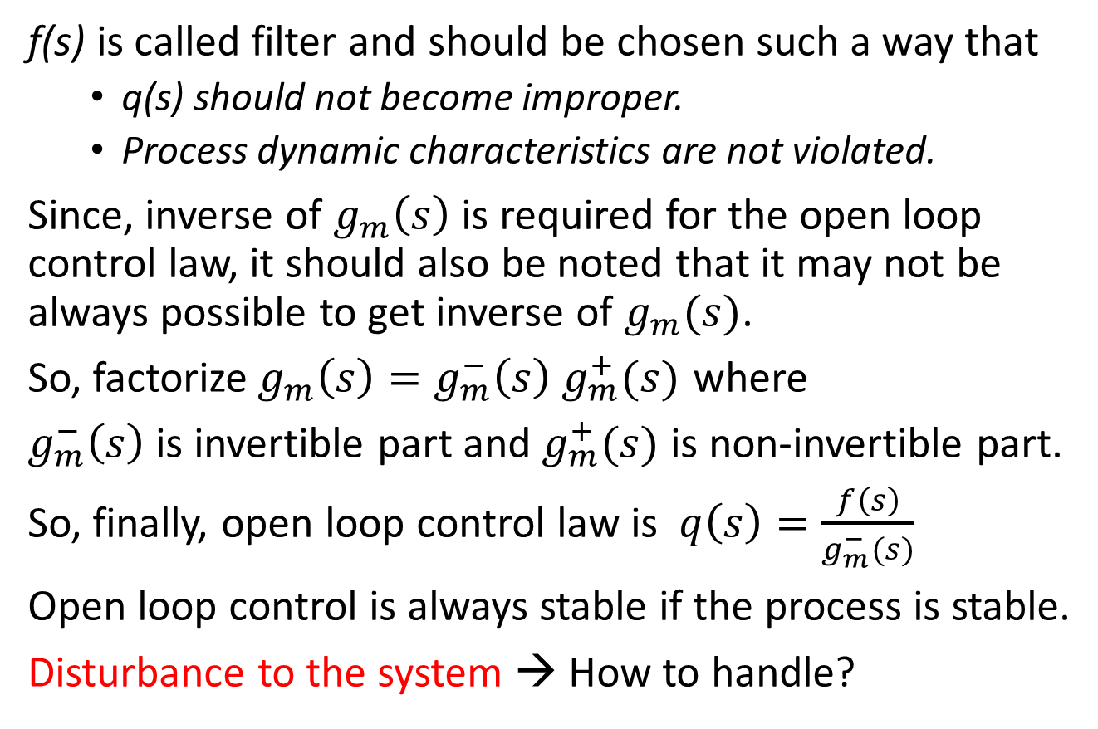
Open loop control
f(s) is called filter and should be chosen such a way that
q(s) should not become improper.
Process dynamic characteristics are not violated.
Since, inverse of $g_{m}\left(s\right)$ is required for the open loop control law, it should also be noted that it may not be always possible to get inverse of $g_{m}(s)$.
So, factorize$g_{m}\left(s\right)=g_{m}^{−}\left(s\right) g_{m}^{+}(s)$ where
$g_{m}^{−}\left(s\right)$ is invertible part and $g_{m}^{+}(s)$ is non-invertible part.
So, finally, open loop control law is $q\left(s\right)=\frac{f\left(s\right)}{g_{m}^{−}(s)}$
Open loop control is always stable if the process is stable.
Disturbance to the system → How to handle?

Slide 4








Internal Model Control
Open loop control law discussed earlier can not take care of disturbances to the process.
How to take care of disturbance?
Disturbance, d is estimated internally using a process model
The above is called Internal Model Control structure.
d
$$y_{sp}$$
$$y_{sp}$$
u
$$y$$
$$q$$
$$g$$
+
+
+
-
$$g_{m}$$
$$y_{m}$$
+
-
$$d_{m}=y−y_{m}$$

Slide 5
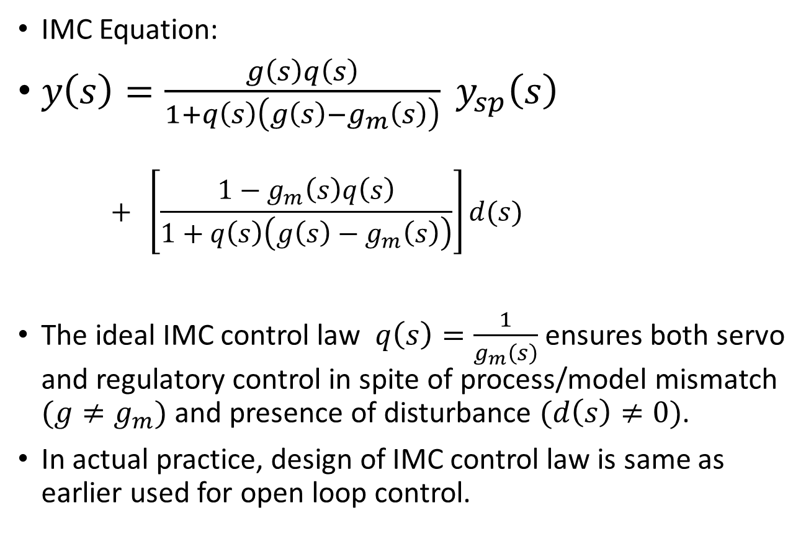
Internal Model Control
IMC Equation:
$y\left(s\right)=\frac{g\left(s\right)q\left(s\right)}{1+q\left(s\right)\left(g\left(s\right)−g_{m}\left(s\right)\right)} y_{sp}\left(s\right)$
$$+ \left[\frac{1−g_{m}\left(s\right)q\left(s\right)}{1+q\left(s\right)\left(g\left(s\right)−g_{m}\left(s\right)\right)}\right]d(s)$$
The ideal IMC control law $q\left(s\right)=\frac{1}{g_{m}\left(s\right)}$ ensures both servo and regulatory control in spite of process/model mismatch $(g≠g_{m})$ and presence of disturbance $(d\left(s\right)≠0)$.
In actual practice, design of IMC control law is same as earlier used for open loop control.

Slide 6
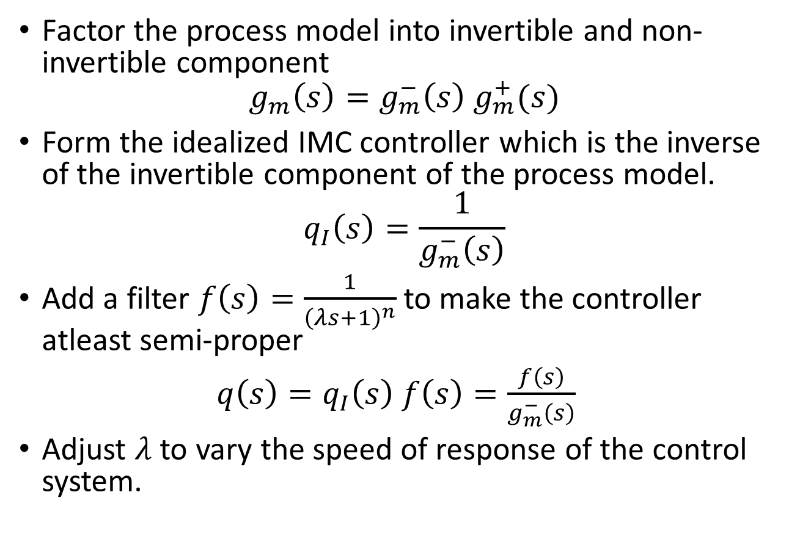
IMC Design Procedure
Factor the process model into invertible and non-invertible component
$$g_{m}\left(s\right)=g_{m}^{−}\left(s\right) g_{m}^{+}(s)$$
Form the idealized IMC controller which is the inverse of the invertible component of the process model.
$$q_{I}\left(s\right)=\frac{1}{g_{m}^{−}\left(s\right)}$$
Add a filter $f\left(s\right)=\frac{1}{{\left(λs+1\right)}^{n}}$ to make the controller atleast semi-proper
$q\left(s\right)=q_{I}\left(s\right) f\left(s\right)=\frac{f\left(s\right)}{g_{m}^{−}\left(s\right)}$
Adjust $λ$ to vary the speed of response of the control system.

Slide 7
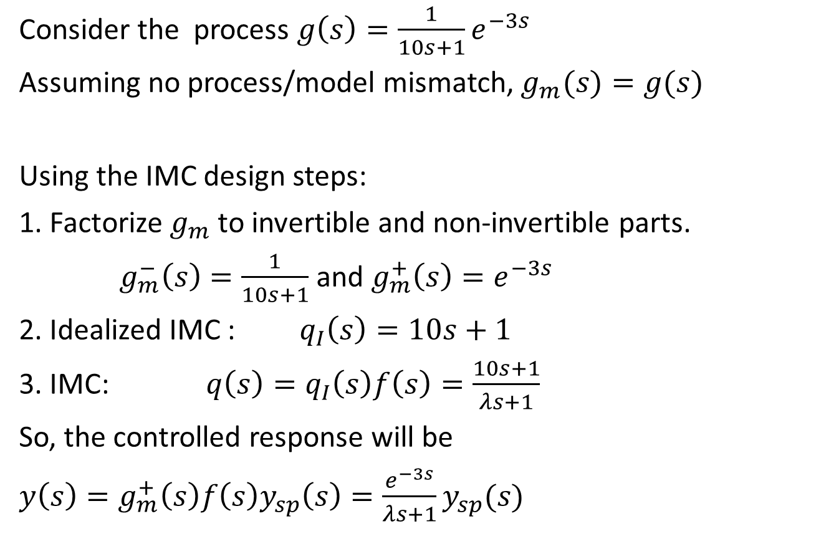
Example-1: FODT Process
Consider the process $g\left(s\right)=\frac{1}{10s+1}e^{−3s}$
Assuming no process/model mismatch, $g_{m}(s)=g(s)$
Using the IMC design steps:
1. Factorize $g_{m}$ to invertible and non-invertible parts.
$g_{m}^{−}\left(s\right)=\frac{1}{10s+1}$ and $g_{m}^{+}\left(s\right)=e^{−3s}$
2. Idealized IMC : $q_{I}\left(s\right)=10s+1$
3. IMC: $q\left(s\right)=q_{I}\left(s\right)f\left(s\right)=\frac{10s+1}{λs+1}$
So, the controlled response will be
$y\left(s\right)=g_{m}^{+}\left(s\right)f\left(s\right)y_{sp}\left(s\right)=\frac{e^{−3s}}{λs+1}y_{sp}(s)$

Slide 8
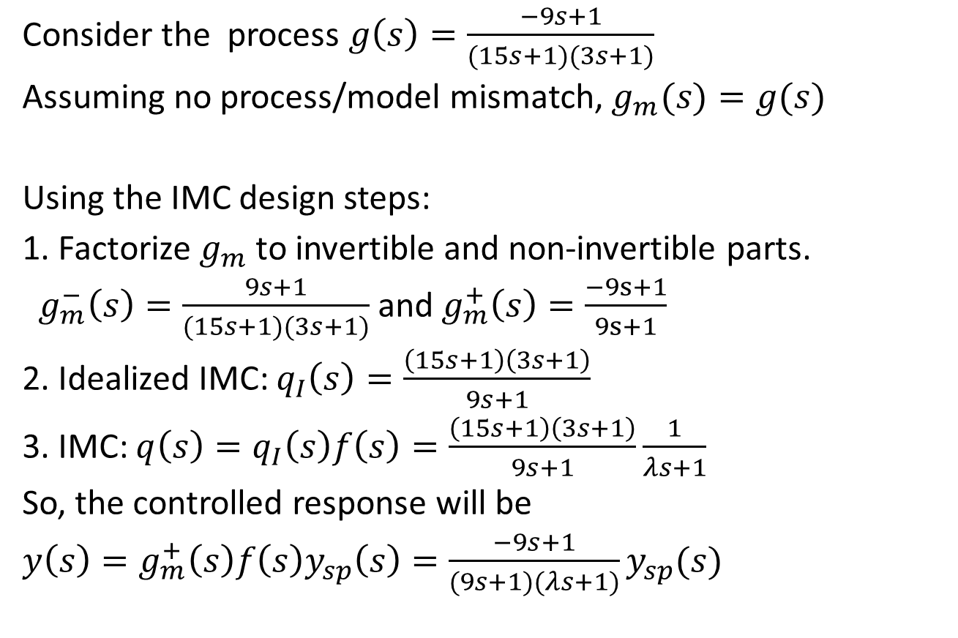
Example-2: SO with RHP zero
Consider the process $g\left(s\right)=\frac{−9s+1}{(15s+1)(3s+1)}$
Assuming no process/model mismatch, $g_{m}(s)=g(s)$
Using the IMC design steps:
1. Factorize $g_{m}$ to invertible and non-invertible parts.
$g_{m}^{−}\left(s\right)=\frac{9s+1}{(15s+1)(3s+1)}$ and $g_{m}^{+}\left(s\right)=\frac{−9s+1}{9s+1}$
2. Idealized IMC: $q_{I}\left(s\right)=\frac{\left(15s+1\right)\left(3s+1\right)}{9s+1}$
3. IMC: $q\left(s\right)=q_{I}\left(s\right)f\left(s\right)=\frac{\left(15s+1\right)\left(3s+1\right)}{9s+1}\frac{1}{λs+1}$
So, the controlled response will be
$y\left(s\right)=g_{m}^{+}\left(s\right)f\left(s\right)y_{sp}\left(s\right)=\frac{−9s+1}{(9s+1)(λs+1)}y_{sp}(s)$

Slide 9














IMC based PID Controller
d
$$y_{sp}$$
u
+
$$y$$
+
$$q$$
$$g$$
+
-
$$g_{m}$$
$$y_{m}$$
+
-
IMC structure
$$d_{m}=y−y_{m}$$
d
PID Controller $g_{c}$
$$y_{sp}$$
+
$$q$$
u
$$g$$
+
$$y$$
+
+
-
+
$$y_{m}$$
$$g_{m}$$
Feedback Structure

Slide 10
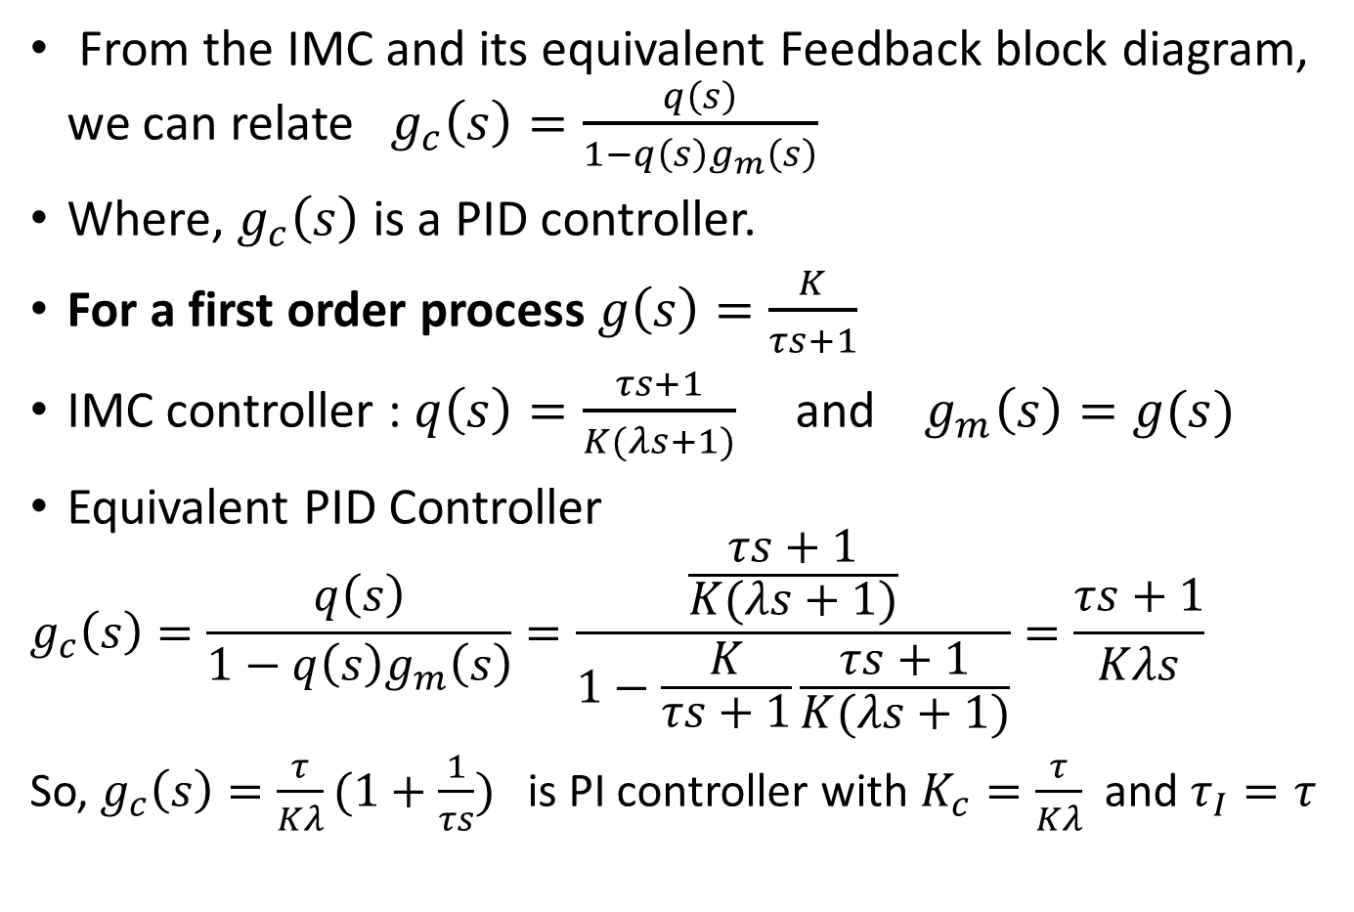
IMC based PID Controller design
From the IMC and its equivalent Feedback block diagram, we can relate $g_{c}\left(s\right)=\frac{q\left(s\right)}{1−q\left(s\right)g_{m}\left(s\right)}$
Where, $g_{c}\left(s\right)$ is a PID controller.
For a first order process $g\left(s\right)=\frac{K}{τs+1}$
IMC controller : $q\left(s\right)=\frac{τs+1}{K(λs+1)}$ and $g_{m}\left(s\right)=g(s)$
Equivalent PID Controller
$$g_{c}\left(s\right)=\frac{q\left(s\right)}{1−q\left(s\right)g_{m}\left(s\right)}=\frac{\frac{τs+1}{K(λs+1)}}{1−\frac{K}{τs+1}\frac{τs+1}{K(λs+1)}}=\frac{τs+1}{Kλs}$$
So, $g_{c}\left(s\right)=\frac{τ}{Kλ}(1+\frac{1}{τs})$ is PI controller with $K_{c}=\frac{τ}{Kλ}$ and $τ_{I}=τ$

Slide 11
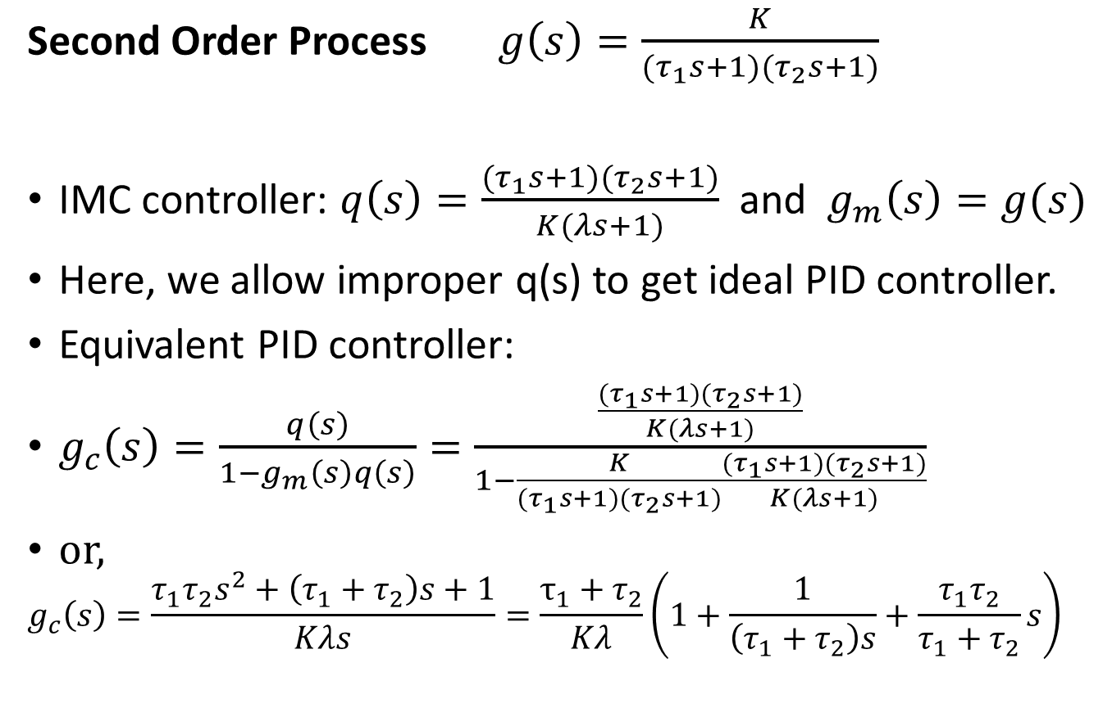
IMC based PID Controller Design
Second Order Process $g\left(s\right)=\frac{K}{{(τ}_{1}s+1)(τ_{2}s+1)}$
IMC controller: $q\left(s\right)=\frac{{(τ}_{1}s+1)(τ_{2}s+1)}{K(λs+1)}$ and $g_{m}\left(s\right)=g(s)$
Here, we allow improper q(s) to get ideal PID controller.
Equivalent PID controller:
$g_{c}\left(s\right)=\frac{q\left(s\right)}{1−g_{m}\left(s\right)q\left(s\right)}=\frac{\frac{{(τ}_{1}s+1)(τ_{2}s+1)}{K(λs+1)}}{1−\frac{K}{{(τ}_{1}s+1)(τ_{2}s+1)}\frac{{(τ}_{1}s+1)(τ_{2}s+1)}{K(λs+1)}}$
or,
$$g_{c}\left(s\right)=\frac{τ_{1}τ_{2}s^{2}+\left(τ_{1}+τ_{2}\right)s+1}{Kλs}=\frac{τ_{1}+τ_{2}}{Kλ}\left(1+\frac{1}{\left(τ_{1}+τ_{2}\right)s}+\frac{τ_{1}τ_{2}}{τ_{1}+τ_{2}}s\right)$$

Slide 12
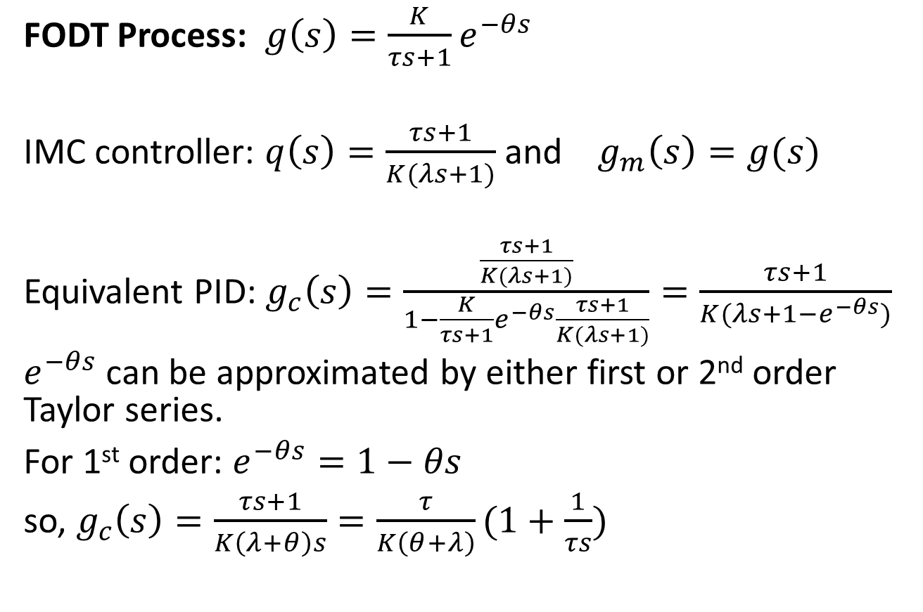
IMC based PID Controller Design
FODT Process: $g\left(s\right)=\frac{K}{τs+1}e^{−θs}$
IMC controller: $q\left(s\right)=\frac{τs+1}{K(λs+1)}$ and $g_{m}\left(s\right)=g(s)$
Equivalent PID: $g_{c}\left(s\right)=\frac{\frac{τs+1}{K(λs+1)}}{1−\frac{K}{τs+1}e^{−θs}\frac{τs+1}{K(λs+1)}}=\frac{τs+1}{K(λs+1−e^{−θs})}$
$e^{−θs}$ can be approximated by either first or 2nd order Taylor series.
For 1st order: $e^{−θs}=1−θs$
so, $g_{c}\left(s\right)=\frac{τs+1}{K\left(λ+θ\right)s}=\frac{τ}{K\left(θ+λ\right)}(1+\frac{1}{τs})$

Slide 13
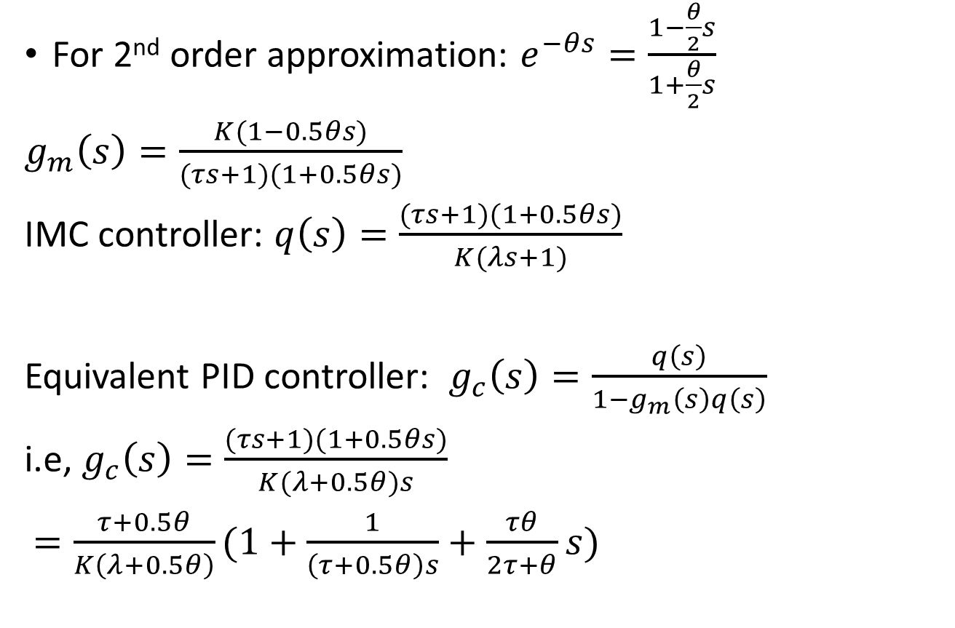
IMC based PID Controller Design
For 2nd order approximation: $e^{−θs}=\frac{1−\frac{θ}{2}s}{1+\frac{θ}{2}s}$
$g_{m}\left(s\right)=\frac{K(1−0.5θs)}{(τs+1)(1+0.5θs)}$
IMC controller: $q\left(s\right)=\frac{(τs+1)(1+0.5θs)}{K(λs+1)}$
Equivalent PID controller: $g_{c}\left(s\right)=\frac{q\left(s\right)}{1−g_{m}\left(s\right)q\left(s\right)}$
i.e, $g_{c}\left(s\right)=\frac{(τs+1)(1+0.5θs)}{K(λ+0.5θ)s}$
$=\frac{τ+0.5θ}{K\left(λ+0.5θ\right)}(1+\frac{1}{\left(τ+0.5θ\right)s}+\frac{τθ}{2τ+θ}s)$

Slide 14
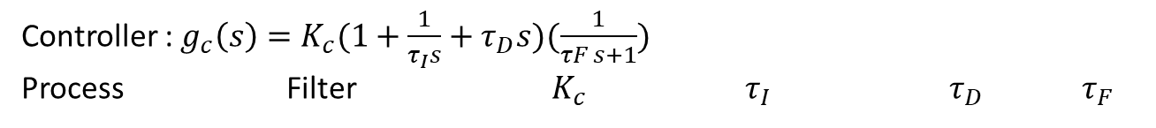
IMC based PID Controller Design
Controller : $g_{c}\left(s\right)=K_{c}(1+\frac{1}{τ_{I}s}+τ_{D}s)(\frac{1}{τF s+1})$
Process Filter $K_{c}$ $τ_{I}$ $τ_{D}$ $τ_{F}$

Slide 15
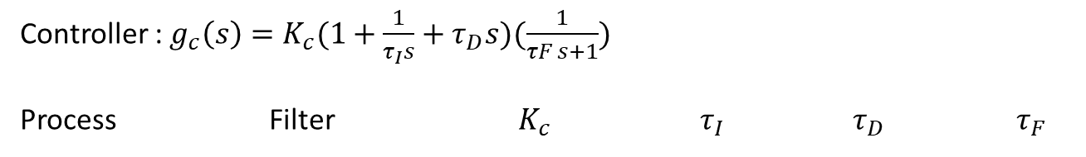
IMC based PID Controller Design
Controller : $g_{c}\left(s\right)=K_{c}(1+\frac{1}{τ_{I}s}+τ_{D}s)(\frac{1}{τF s+1})$
Process Filter $K_{c}$ $τ_{I}$ $τ_{D}$ $τ_{F}$

Slide 16
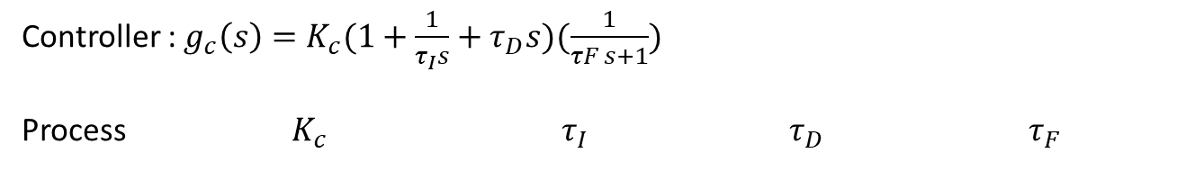
Controller : $g_{c}\left(s\right)=K_{c}(1+\frac{1}{τ_{I}s}+τ_{D}s)(\frac{1}{τF s+1})$
Process $K_{c}$ $τ_{I}$ $τ_{D}$ $τ_{F}$

Slide 17
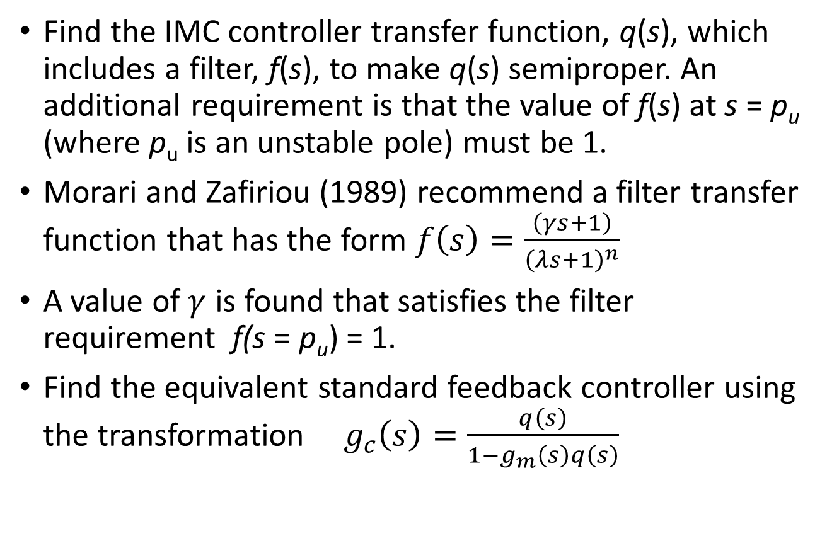
IMC based PID for unstable process
Find the IMC controller transfer function, q(s), which includes a filter, f(s), to make q(s) semiproper. An additional requirement is that the value of f(s) at s = p_{u} (where p_{u} is an unstable pole) must be 1.
Morari and Zafiriou (1989) recommend a filter transfer function that has the form $f\left(s\right)=\frac{\left(γs+1\right)}{{\left(λs+1\right)}^{n}}$
A value of $γ$ is found that satisfies the filter requirement f(s = p_{u}) = 1.
Find the equivalent standard feedback controller using the transformation ${ g}_{c}\left(s\right)=\frac{q\left(s\right)}{1−g_{m}\left(s\right)q\left(s\right)}$

Slide 18
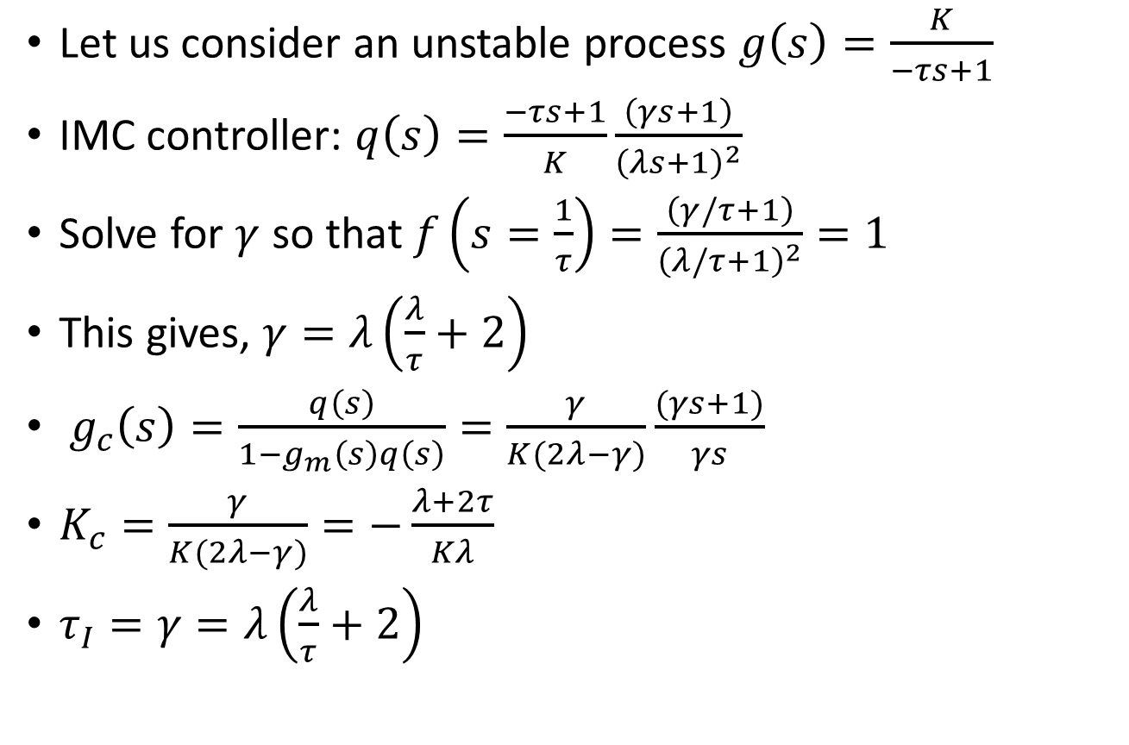
Example
Let us consider an unstable process $g\left(s\right)=\frac{K}{−τs+1}$
IMC controller: $q\left(s\right)=\frac{−τs+1}{K}\frac{\left(γs+1\right)}{{\left(λs+1\right)}^{2}}$
Solve for $γ$ so that $f\left(s=\frac{1}{τ}\right)=\frac{\left(γ/τ+1\right)}{{\left(λ/τ+1\right)}^{2}}=1$
This gives, $γ=λ\left(\frac{λ}{τ}+2\right)$
${ g}_{c}\left(s\right)=\frac{q\left(s\right)}{1−g_{m}\left(s\right)q\left(s\right)}=\frac{γ}{K(2λ−γ)}\frac{(γs+1)}{γs}$
$K_{c}=\frac{γ}{K(2λ−γ)}=−\frac{λ+2τ}{Kλ}$
$τ_{I}=γ=λ\left(\frac{λ}{τ}+2\right)$

Slide 19
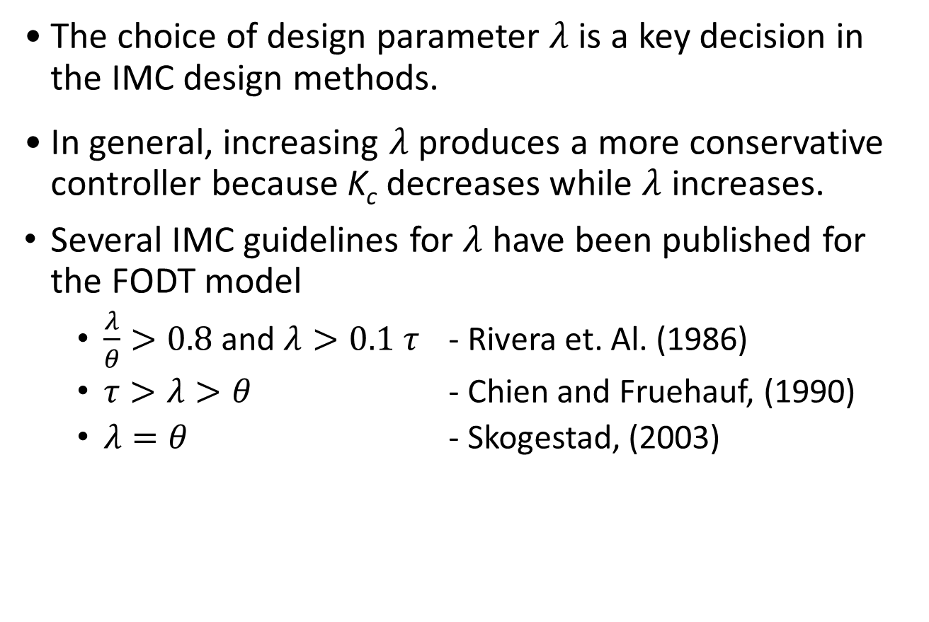

Selection of $λ$
The choice of design parameter $λ$ is a key decision in the IMC design methods.
In general, increasing $λ$ produces a more conservative controller because K_{c} decreases while $λ$ increases.
Several IMC guidelines for $λ$ have been published for the FODT model
$\frac{λ}{θ}>0.8$ and $λ>0.1 τ$ - Rivera et. Al. (1986)
$τ>λ>θ$ - Chien and Fruehauf, (1990)
$λ=θ$ - Skogestad, (2003)

Slide 20
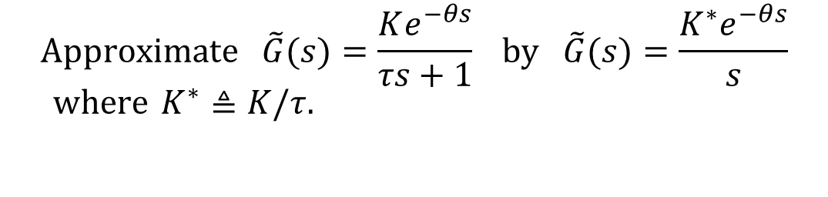

Tuning for Lag-Dominant Models
First- or second-order models with relatively small time delays are referred to as lag-dominant models.
The IMC and DS methods provide satisfactory set-point responses, but very slow disturbance responses, because the value of is very large.
Fortunately, this problem can be solved in three different ways.
Method 1: Integrator Approximation
$$\left(θ/τ≪1\right)$$
$$\text{Approximate} \tilde{G}(s)=\frac{Ke^{−θs}}{τs+1} \text{by} \tilde{G}(s)=\frac{K^{∗}e^{−θs}}{s} \\ \text{where} K^{∗}≜K/τ.$$
Then use the IMC tuning rules to specify the controller settings.

Slide 21
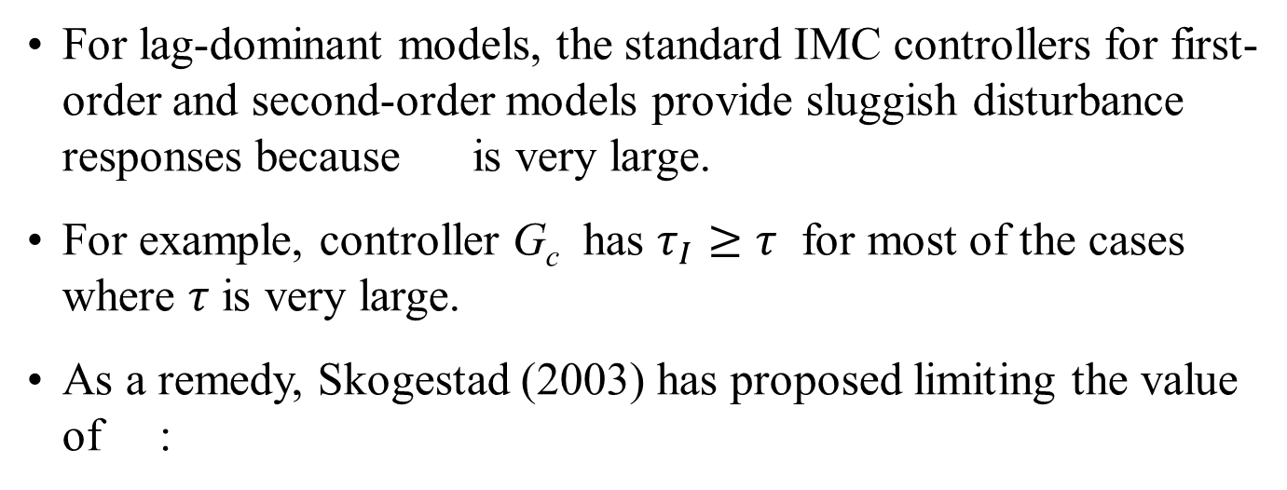
Method 2. Limit the Value of τ_{I}
For lag-dominant models, the standard IMC controllers for first-order and second-order models provide sluggish disturbance responses because is very large.
For example, controller G_{c} has $τ_{I}≥τ$ for most of the cases where $τ$ is very large.
As a remedy, Skogestad (2003) has proposed limiting the value of :
where τ₁ is the largest time constant (if there are two).
Method 3. Design the Controller for Disturbances, Rather
Set-point Changes
The desired CLTF is expressed in terms of (Y/D)_{des}, rather than (Y/Y_{sp})_{des}
Reference: Chen & Seborg (2002)

Slide 22
Example
Consider a lag-dominant model with
Design four PI controllers:
IMC
IMC based on the integrator approximation
IMC with Skogestad’s modification
Direct Synthesis method for disturbance rejection (Chen and Seborg, 2002): The controller settings are K_{c} = 0.551 and

Slide 23
Evaluate the four controllers by comparing their performance for unit step changes in both set point and disturbance. Assume that the model is perfect and that G_{d}(s) = G(s).
Solution
The PI controller settings are:
Controller | K_{c}
IMC | 0.5 | 100
(b) Integrator approximation | 0.556 | 5
(c) Skogestad | 0.5 | 8
(d) DS-d | 0.551 | 4.91

Slide 24
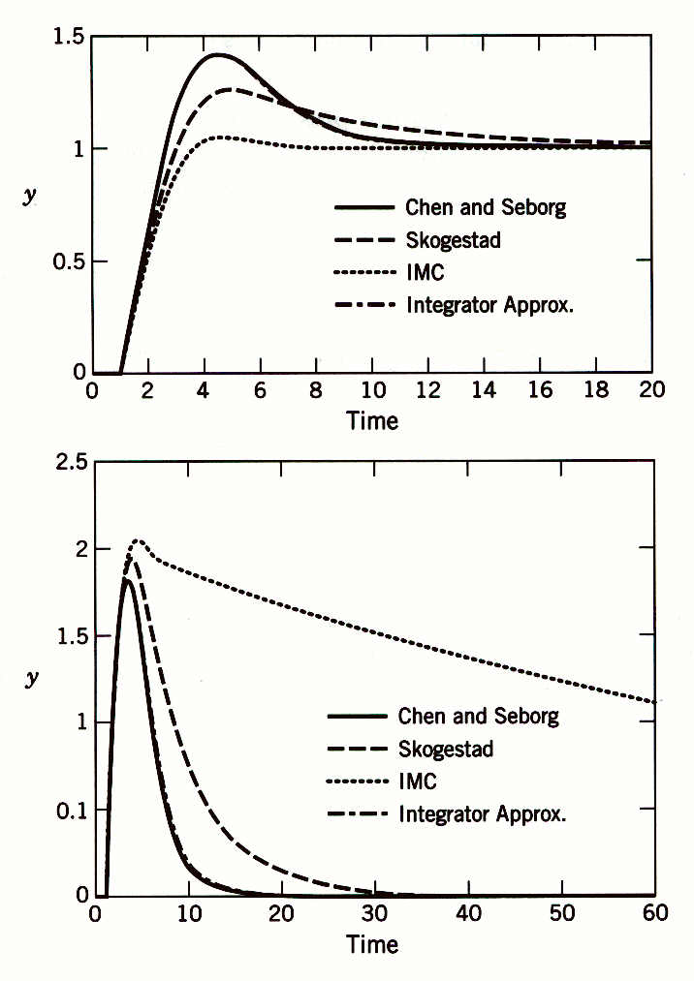
Comparison of set-point responses (top) and disturbance responses (bottom). The responses for the Chen and Seborg and integrator approximation methods are essentially identical.

